Slide 1

Presentation for Haukainga Home Winds
Presented by: Michael Amann, Talgat Narbaev, Lukas Weitzer

Slide 2
Overview of Business
Here we will look at what Haukainga Home Winds is, what it values, and what its goals are as we give a general overview of the business.

Slide 3
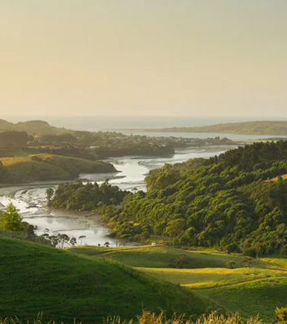
Overview of Business
Haukainga Home Winds is

Slide 4
Our Proposed Product
Here we will outline and explain the product we have been developing for Haukainga Home Winds…

Slide 5

Our Proposed Product
Web Application using WordPress + Plugins
Hotel Booking Lite
Ultimate Member
WP Mail SMTP
WP Map Block
Elementor

Slide 6
Type - Web Application
For Haukainga Home Winds, we have decided to use the WordPress framework and additional Plugins and Themes.
Maintainability
Security
Scalability and Performance

Slide 7
Functionality
Property Managment
Create, modify and delete properties
Booking Management
Place, cancel and manage bookings
Rates, services and booking rules can be added
User Management
Create, modify and delete accounts
Manage permissions of users and user groups

Slide 8
Design
The design of this …

Slide 9
Design – Color Palette
This color palette …

Slide 10
Highlights from our Work
Here we will showcase the highlights of our work to date…

Slide 11
Highlights
Using WordPress’ …

Slide 12
Constraints and Boundaries of the Project
Here we will discuss factors that have contributed to the detriment of project progress…

Slide 13

Constraints
Additional payment features need business related information

Slide 14
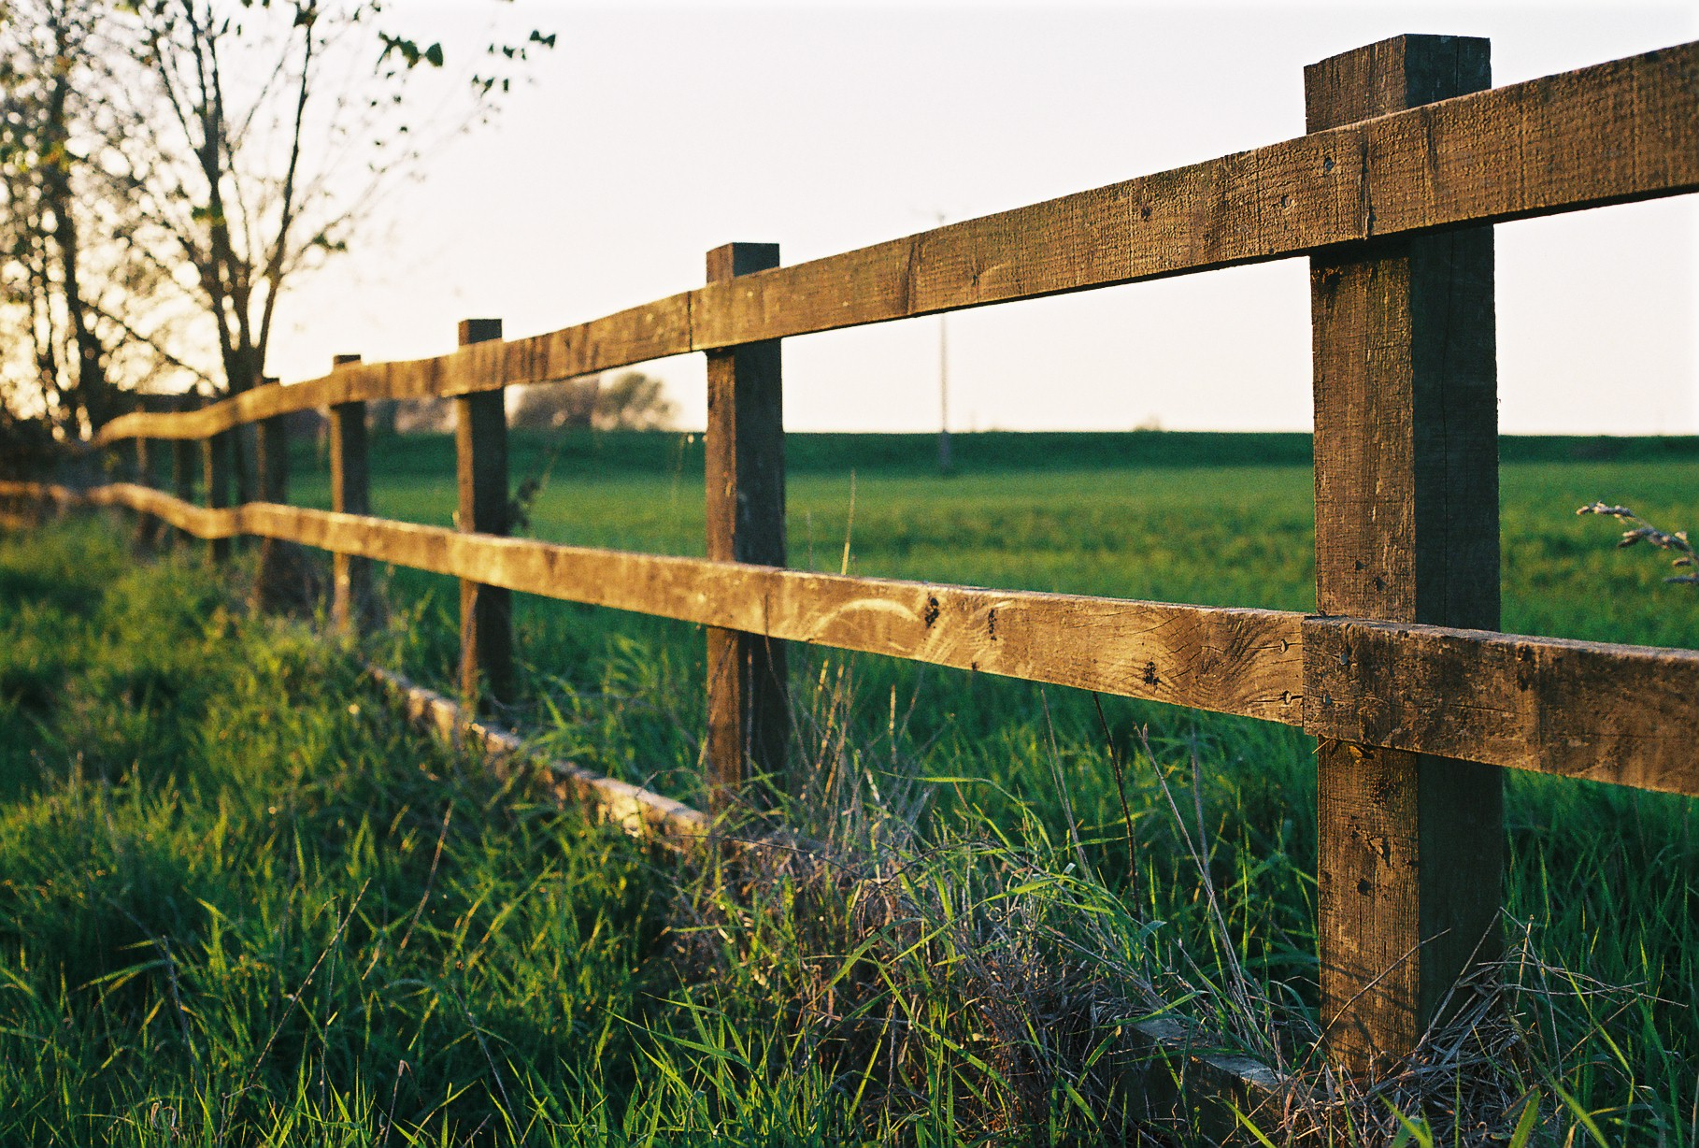
Boundaries
Free version of Hotel Booking Lite
Photo ID implemented but recommend payed plugin

Slide 15

In Summary…
We believe we created a web application that matches the requirements and expectations of our client.
The website is easy to use, intuitive and reliable.
Using WordPress and business grade Plugins

Slide 16

Thank You

Slide 17

Image References
Images sourced through Google image search.
(Slide 3) Maori-land-rwid.jpg: https://waateanews.com/wp-content/uploads/2021/08/maori-land-rwid.jpg

